Slide 1

CN101.3 - Data Communication and Network
Department of Network and Security
Data link Layer
Isuru Sri Bandara
isuru.s@nsbm.ac.lk

Slide 2


What is a Protocol ?
A set of rules or procedures for transmitting data between electronic devices.
Example TCP, UDP

Slide 3

Any Examples ?
HTTP
HTTPS
FTP
SSH
What else ?

Slide 4
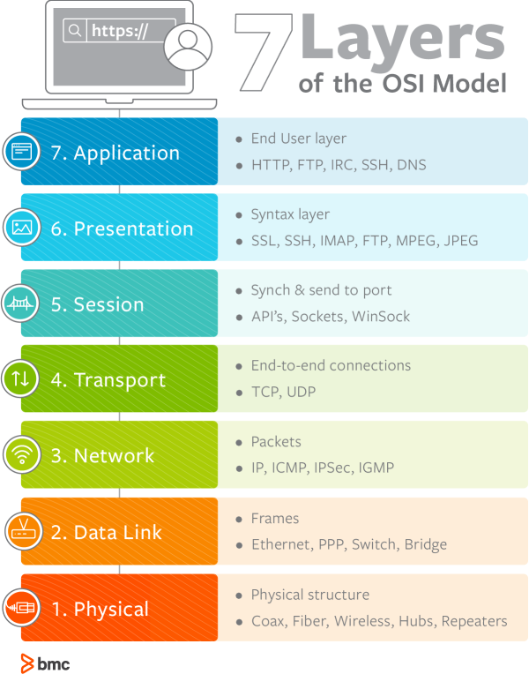
OSI Model- Data Link Layer

Slide 5
Data Link Layer Responsible for ?
Data Link layer is responsible for implementation of point-to-point flow and error control mechanism
Some requirements and objectives for effective data communication between two directly connected transmitting – receiving stations are
Flow Control
Frame Synchronization
Error Control

Slide 6
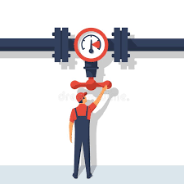
Flow Control
Technique for assuring that a transmitting entity does not over- whelm a receiving entity data
The receiving entity typically allocates a data buffer of some maximum length for a transfer

Slide 7
Flow Control Cont.
When data are received the receiver must do a certain amount of processing before passing the data to the higher-level software
In the absence of flow control, the receiver’s buffer may fill up and overflow while it is processing old data

Slide 8
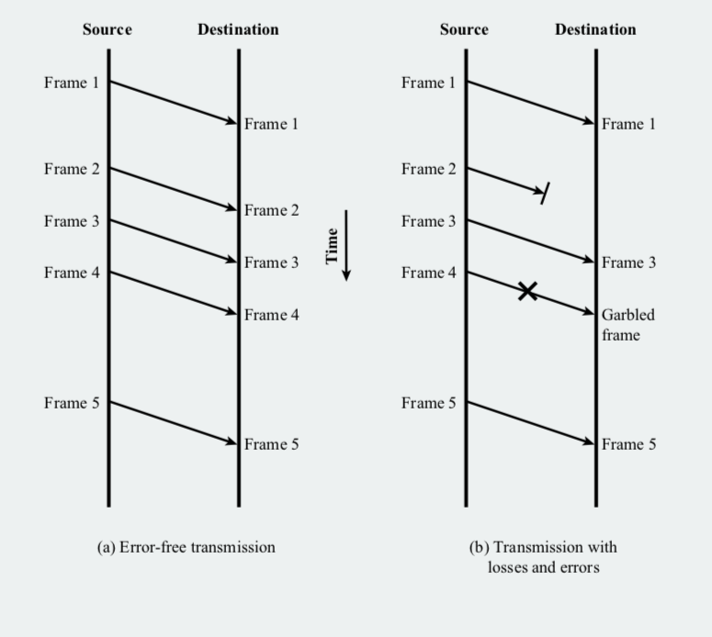
Model of Frame Transmission

Slide 9
Methods to control the flow
Stop and Wait Flow Control
Sliding Window Flow Control

Slide 10
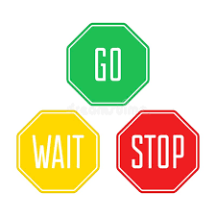
Stop and Wait Flow Control
This flow control mechanism forces the sender after transmitting a data frame to stop and wait until the acknowledgement of the data-frame sent is received.

Slide 11
Stop and Wait Flow Control Cont.
Simplest form of flow control
Source transmits frame
Destination receive frame and replies with acknowledgement (ACK)
Source waits for ACK before sending next frame
Destination can stop flow by not sending ACK

Slide 12
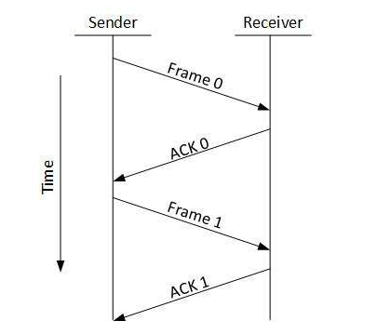
Stop and Wait Flow Control Cont.

Slide 13

Sliding Window Flow Control
In this flow control mechanism, both sender and receiver agree on the number of data-frames after which the acknowledgement should be sent.

Slide 14

Sliding Window Flow Control Cont.
Receiver has buffer n long
Transmitter sends up to n frames without ACK
ACK includes number of next frame expected
Receiver can ACK frames without permitting further
transmission. (Receive not Ready)

Slide 15
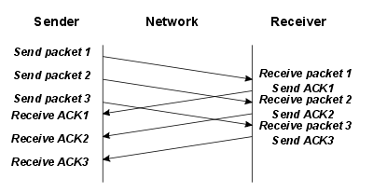
Sliding Window Flow Control Cont.

Slide 16
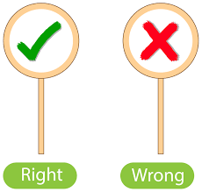
Error Control Techniques
When data frame is transmitted, there is a possibility that data frame may be lost in the transit, or it is received corrupted.

Slide 17
Error Control Techniques Cont.
Requirements for error control mechanism
Error Detection – The sender and receiver, either both or any, must ascertain that there is some error in the transit
Retransmission after timeout – If an ACK of a data-frame previously transmitted does not arrive before the timeout the sender retransmits the frame
Positive ACK - When the receiver receives a correct frame, it should
acknowledge it.
Negative ACK – When the receiver receives a damaged frame or
a duplicate frame, it sends a NACK
.

Slide 18
Error Control Techniques Cont.
Requirements for error control mechanism
Error Detection – The sender and receiver, either both or any, must ascertain that there is some error in the transit
Retransmission after timeout – If an ACK of a data-frame previously transmitted does not arrive before the timeout the sender retransmits the frame
Positive ACK - When the receiver receives a correct frame, it should acknowledge it.
Negative ACK – When the receiver receives a damaged frame or
a duplicate frame, it sends a NACK
.

Slide 19
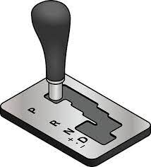
Automatic Repeat Request ARQ
Collective Name for error control mechanism
Versions of ARQ,
Stop and wait ARQ
Go-Back-N ARQ
Selective Reject ARQ

Slide 20
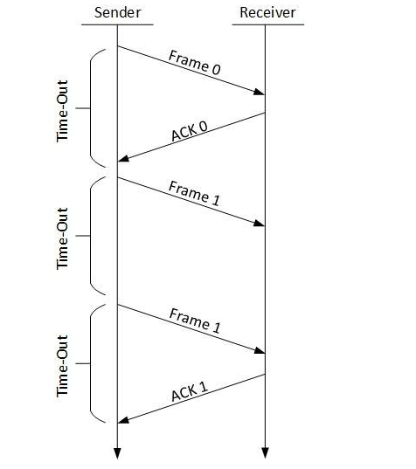
Stop-and-wait ARQ

Slide 21

Stop-and-wait ARQ Cont.
The following transition may occur in Stop-and-Wait ARQ:
The sender maintains a timeout counter.
When a frame is sent, the sender starts the timeout counter.
If acknowledgement of frame comes in time, the sender transmits the next frame in queue.
If acknowledgement does not come in time, the sender assumes that either the frame or its acknowledgement is lost in transit. Sender retransmits the frame and starts the timeout counter.
If a negative acknowledgement is received, the sender retransmits the frame.

Slide 22
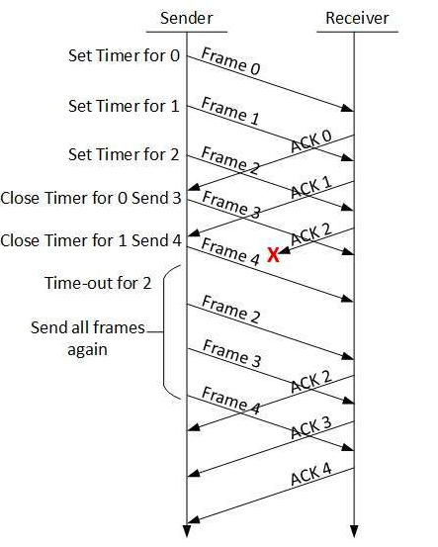
Go-Back-N ARQ

Slide 23

Go-Back-N ARQ Cont.
Stop and wait ARQ mechanism does not utilize the resources at their best, When the acknowledgement is received, the sender sits idle and does nothing.
In Go-Back-N ARQ method, both sender and receiver maintain a window.

Slide 24
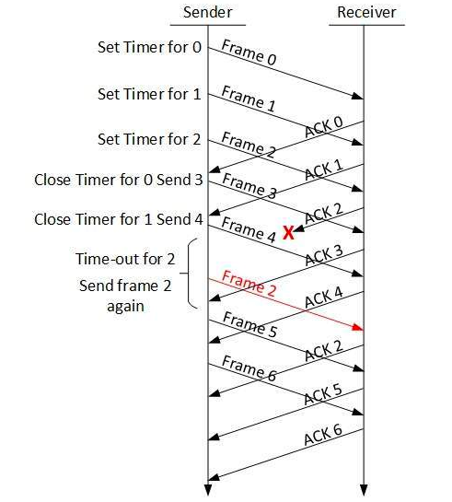
Selective-Reject ARQ

Slide 25

Selective-Reject ARQ Cont.
Also Called selective retransmission
Only rejected frames are retransmitted
Subsequent frames are accepted by the receiver and buffered
Minimize retransmission

Slide 26
ARQ
Stop and Wait ARQ
Go back-n ARQ
Selective ARQ

Slide 27
Thank you !

